Slide 1
22/03/2022
Title: Like Terms
Aim:
Be able to add and subtract like terms using double sign operations.
Plan:
Daily review:
Properties
‘Double sign’ rules
Simplify addition / subtraction expressions.

Slide 2
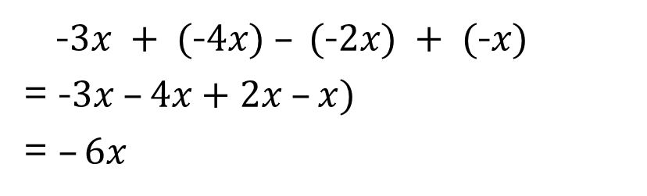
Daily review – double signs
Same signs add, different signs subtract.
Step 1: Simplify double signs
Step 2: Look for ‘like’ terms
Step 3: Add and subtract ‘like’ terms – consider number-line approach
2 – (-4)
= 2 + 4
= 6
5 + (-4)
= 5 – 4
= 1
-5 – (-4)
= -5 + 4
= -1
-5 + (-4)
= -5 – 4
= -9
2 – (-4) + (-2) – (-1)
= 2 + 4 – 2 + 1
= 5
-$3x + (\text{−}4x) – (\text{−}2x) + (\text{−}x)$
= -$3x –4x+2x –x)$
= $–6x$
Notes:
Students complete as guided notes

Slide 3
Daily review – double signs
Same signs add, different signs subtract.
Step 1: Simplify double signs
Step 2: Look for ‘like’ terms
Step 3: Add and subtract ‘like’ terms – consider number-line approach
2 – (-4)
= 2 + 4
= 6
5 + (-4)
= 5 – 4
= 1
-5 – (-4)
= -5 + 4
= -1
-5 + (-4)
= -5 – 4
= -9
2 – (-4) + (-2) – (-1)
= 2 + 4 – 2 + 1
= 5
-$3x + (\text{−}4x) – (\text{−}2x) + (\text{−}x)$
= -$3x –4x+2x –x)$
= $–6x$

Slide 4
Practice 1 – simplify in exercise book
10e + 3e
3d + 5d
19x – 5x
10w + 3e + 2w + 5e
2d + 3d – 7d
2z + 3x + 6y + 4z – 2x + 4y
3x – (-2x) + 5y
-4f + (-2f) + 8f
Answers
13e
8d
14x
12w + 8e
-2d
6z + x + 10y
5x + 5y
2f

Slide 5
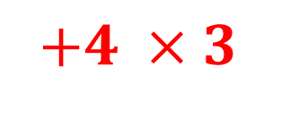
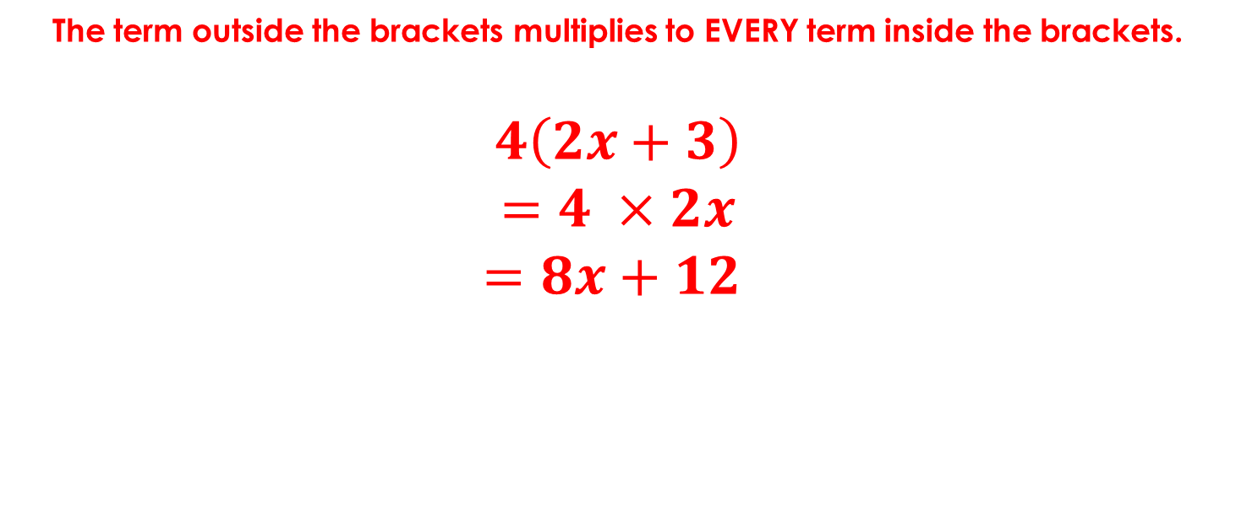
DPM/A Review
The term outside the brackets multiplies to EVERY term inside the brackets.
$$4\left(2x+3\right)$$
$$=4 ×2x$$
$$=8x+12$$
$$+4 ×3$$
HINT: it may be easier to simplify in side the brackets first (IF POSSIBLE)

Slide 6
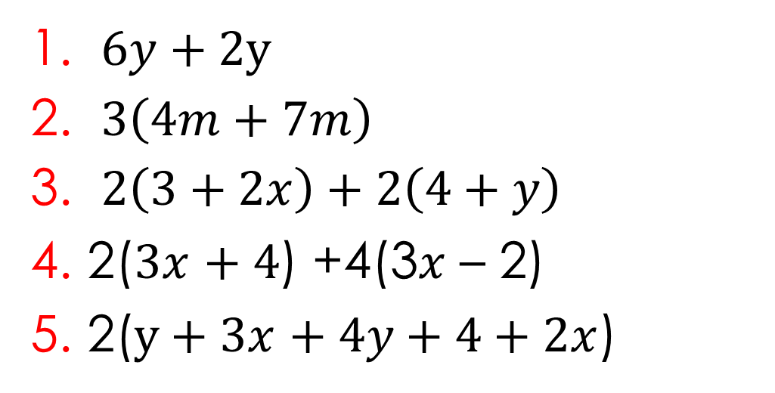
Exercise books
Simplify each of the following
Answers
8y
33m
14 + 4x + 2y
18x
10x + 10y + 8
$6y+$ 2y
$3\left(4m+7m\right)$
$2\left(3+2x\right)+2\left(4+y\right)$
2($3x$ $+ 4$) +4(3$x$ – 2)
2($y+3x$ $+ 4y+4+2x$)
HINT: it may be easier to simplify in side the brackets first (IF POSSIBLE)
Notes:
Student worksheet

Slide 7
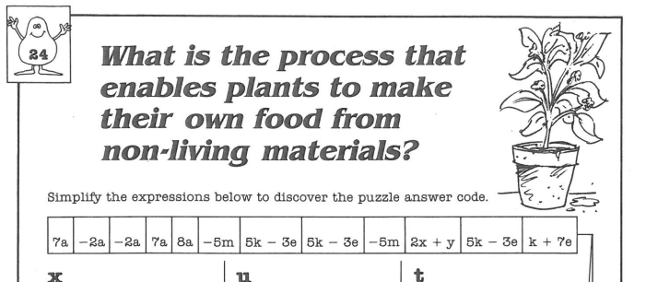
Complete

Slide 8
Reflection – fist to 5
Aim:
Be able to add and subtract like terms using double sign operations.
Rate yourself and record it in our lesson objective.

